Slide 1
3D Smooth Path Planning for a UAV
By: -
Group 24
Revati Naik (116723015)
Satyarth Praveen (116752749)
Sandeep Kota (116911603)

Slide 2
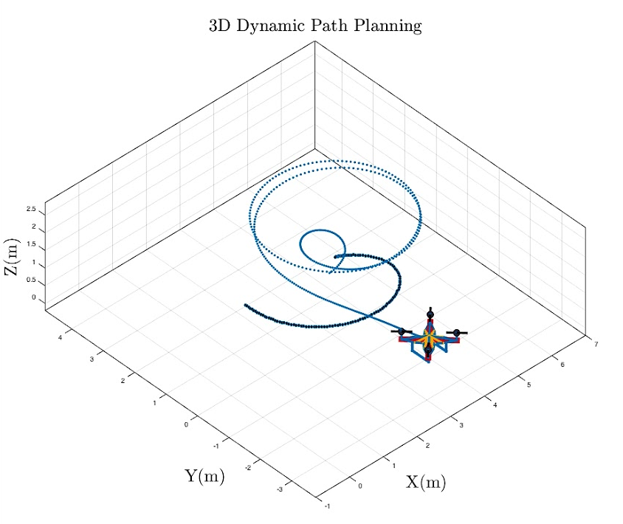
Introduction
UAVs in unexplored regions
Fast-Vechicle dynamics
Compromise on computational time
Sampling-based algorithm

Slide 3

Rapidly- exploring Random Tree
WHAT is RRT?
WHY RRT? Over other algorithms
RRT and RRT*
Pseudo Code
Results
Notes:
High dimensional spaces--------------randomly explores the ci=onfig space

Slide 4
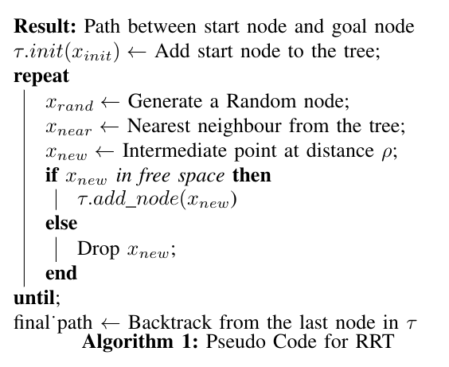
Rapidly- exploring Random Tree - Pseudo Code

Slide 5
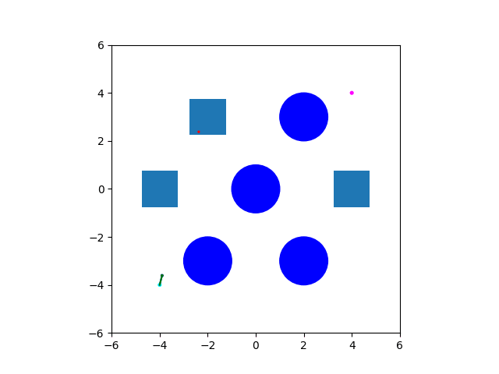
Rapidly- exploring Random Tree - Our Result
Basic parameters used in the code:
Drone Radius: 0.2
Step Size: 0.1
Maximum number of iterations: 750
Results Parameters:
Start Position: -4, -4, 0
Goal Position: 4, 4, 0
Number of iterations used: 451
Number of RRT nodes: 258
Number of nodes in path: 41
Probability of moving towards goal: 60%
Probability of exploration: 40%

Slide 6
Path Pruning
WHAT is path pruning in planning algorithm?
WHICH are the different types of path pruning techniques?
WHY we use this particular approach?
Pseudo Code
Results
Generally the given information is just the set of nodes, and we find the shortest path from it using algos like dijkstra.
But in out case, we have the set of nodes as well as a non-optimal path. So we use this extra information to our advantage and use a much more efficient path pruning method. The next slide talks about the pseudo code.

Slide 7
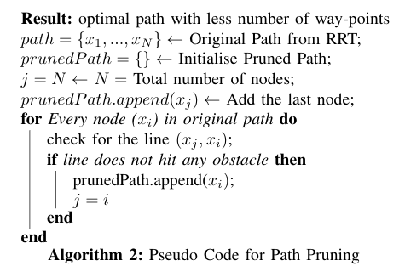
Path Pruning - Pseudo Code

Slide 8
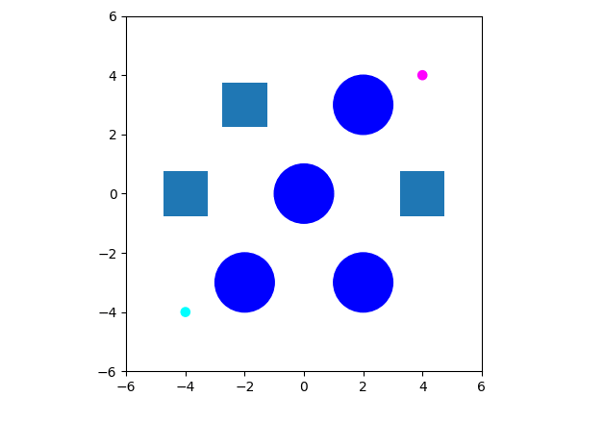
Path Pruning - Our Result
Start from the goal node.
Check if a direct path is available to any of previous node starting from the start node.
Consider parametric equation of line for checking obstacle.
L = A*(t) + B*(1-t)
Where A, B are start and end points of line.
If a direct path is found, add node to pruned path.
Result Parameters:
Length of path from RRT: 41
Length of pruned path: 4

Slide 9
Path Smoothing - Bezier Curves
WHAT is Path Smoothing?
WHY path smoothing in planning algorithms?
WHICH are the different types of path smoothing techniques?
Equations used
Results

Slide 10
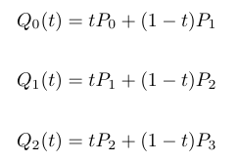
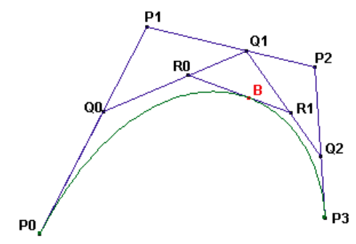
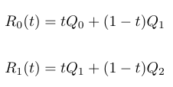
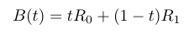
Path Smoothing - Bezier Curves - Equations

Slide 11

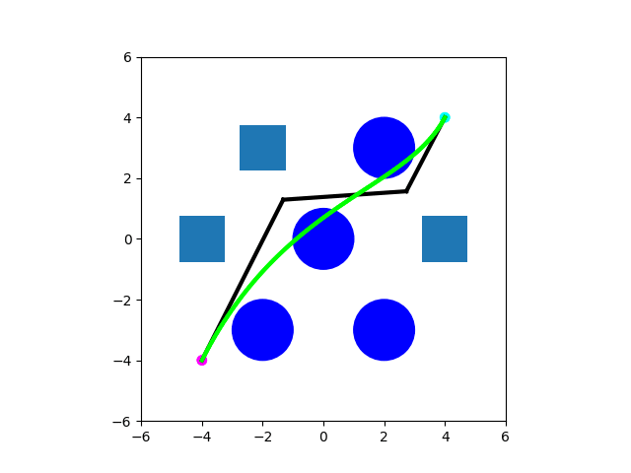
Path Smoothing - Bezier Curves - Results
Smoothing the Original RRT Path
Smoothing the Pruned RRT Path + Updating smooth path to avoid obstacles

Slide 12

Simulation of Unpruned Path

Slide 13
Simulation of Pruned Path

Slide 14
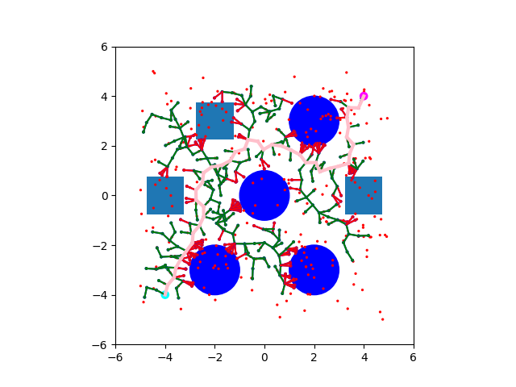
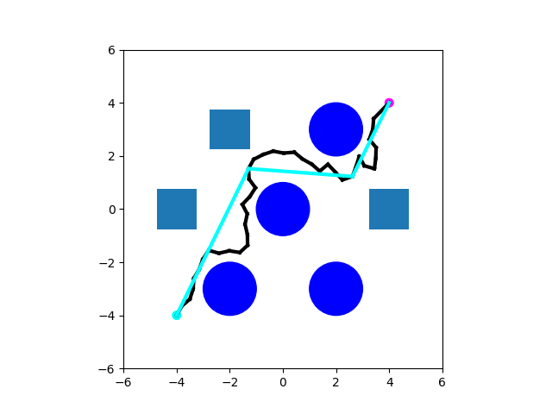
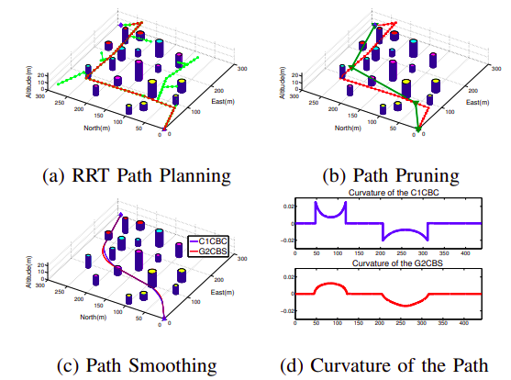

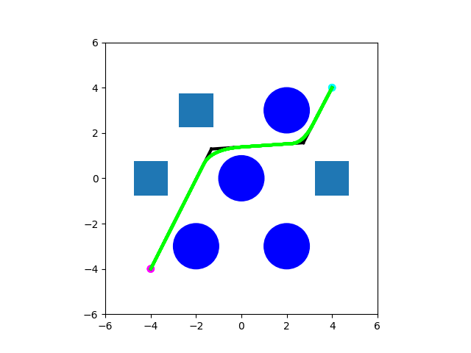
Results From the Paper

Slide 15
THANK YOU

